Slide 1







SHINYHIVE
ARCHITECTURE

Slide 2


SHINYHIVE SERVICES
Smart Bathroom Cleaning and add-on
Services Platform

Slide 3

AGENDA
1. Introduction
2. Objectives
3. System Overview
4. Key Features
5. System Architecture & Tech Stack
6. Demo / Screenshots
7. Challenges & Solutions
8. Q&A

Slide 4



INTRODUCTION TO
SHINYHIVE
At ShinyHive, our goal is to transform everyday cleaning into a smart, efficient, and customer-friendly experience
Through our Bathroom Cleaning and Add-on Services project, we’re building a tech-enabled platform that simplifies service booking, enhances operational efficiency, and ensures consistent quality and hygiene.
CUSTOMER APP
EMPLOYEE APP
SUPER ADMIN PANEL
ADMIN PANEL
SUPERVISOR PANEL

Slide 5

PROJECT OBJECTIVES
1.Build a seamless digital platform for
bathroom cleaning services
2. Provide easy booking with one-time & recurring options
3. Enable secure online payments
4. Automate employee assignment & service tracking
5. Deliver notifications & reminders for reliability

Slide 6

SYSTEM OVERVIEW
Customer App (ShinyHive)
- Book services & add-ons
- Manage one-time / recurring bookings
- Online payments & invoices
- Notifications & reminders
Employee App (ShinyHive Employee)
- Task assignment & updates
- Service history & status management
- Real-time notifications

Slide 7

SYSTEM OVERVIEW
Admin Dashboard
- Manage services, employees, supervisors
& customers
- Track payments & reports
- Configure notifications & schedules

Slide 8



SERVICE FLOW
1. Customer books a service
2. Payment processed securely
3. Employee assigned automatically
4. Reminders & notifications sent
5. Employee completes service
6. Customer feedback collected

Slide 9

KEY FEATURES
CUSTOMER APP
SIMPLE BOOKING INTERFACE
BATHROOM CLEANING AND ADD-ON SERVICES
FLEXIBLE SCHEDULING: ONE-TIME & RECURRING
RAZORPAY/STRIPE INTEGRATION FOR PAYMENTS

Slide 10

KEY FEATURES
EMPLOYEE APP
JOB NOTIFICATIONS
START / COMPLETE SERVICE UPDATES
TASK HISTORY
LOCATION TRACKING (OPTIONAL)

Slide 11
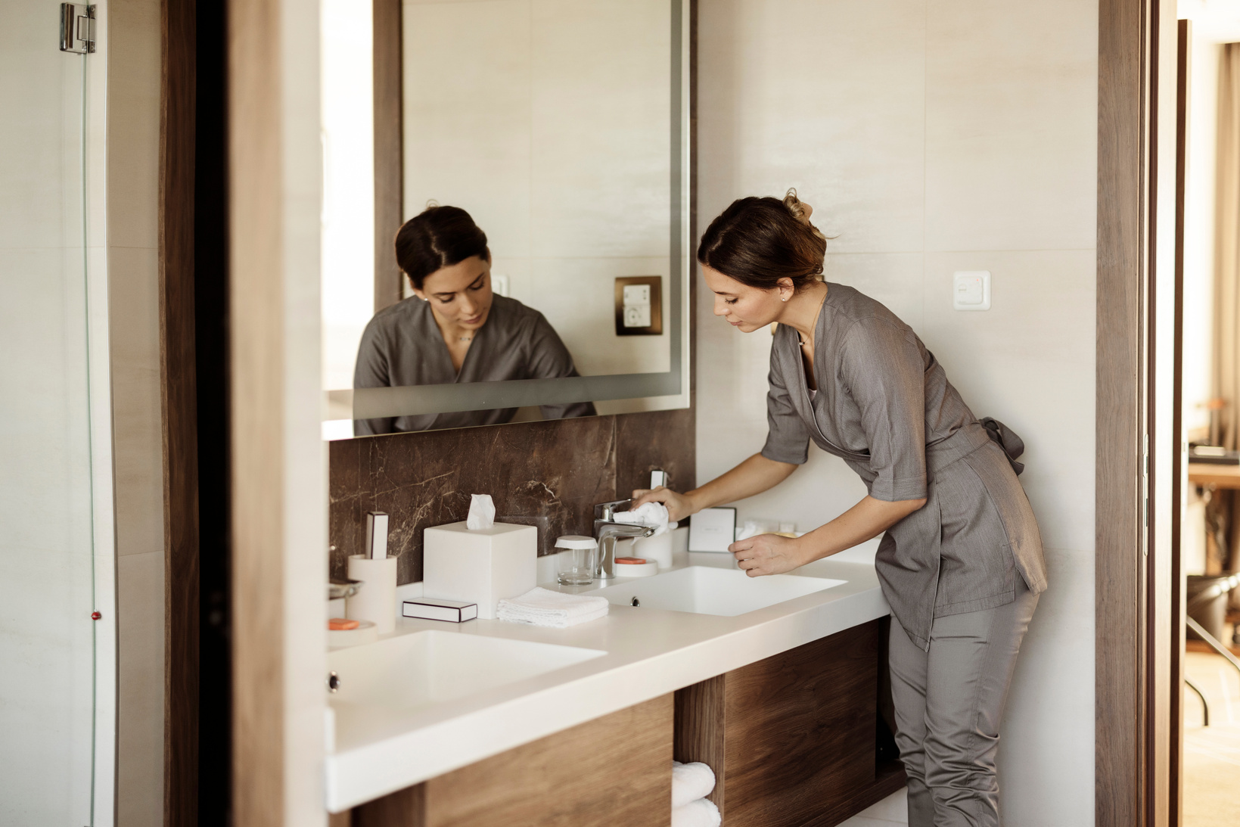






NOTIFICATIONS & QUEUE SYSYEM
BACKGROUND QUEUE SYSTEM FOR PUSH NOTIFICATIONS
REMINDERS FOR UPCOMING SERVICES
REAL-TIME UPDATES FOR EMPLOYEES
SMS/EMAIL AND PUSH NOTIFICATIONS SUPPORT

Slide 12
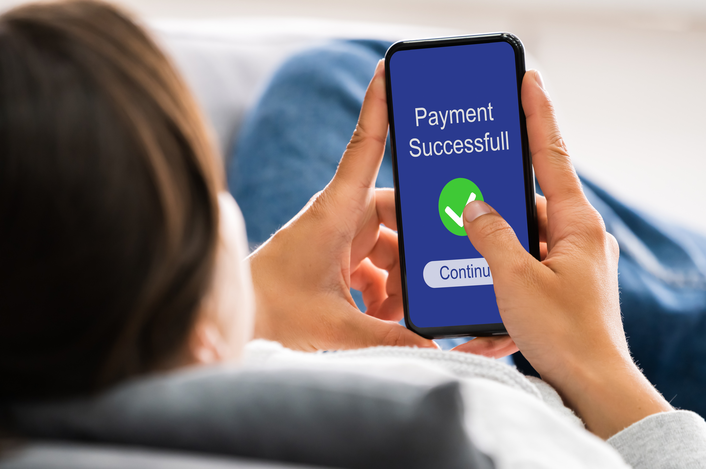




PAYMENT GATEWAY
INTEGRATED RAZORPAY FOR SECURE TRANSACTIONS
SUPPORTS UPI, CARDS, WALLETS, NET BANKING
AUTOMATIC INVOICE GENERATION
HANDLES REFUNDS & FAILURES GRACEFULLY

Slide 13

TECHNICAL STACK
FRONTEND (CUSTOMER & EMPLOYEE): FLUTTER
BACKEND: LARAVEL
DATABASE: MYSQL
QUEUE SYSTEM: DEFAULT LARAVEL QUE SYSTEM
NOTIFICATIONS: FIREBASE, SMS, EMAIL
PAYMENTS: RAZORPAY

Slide 14
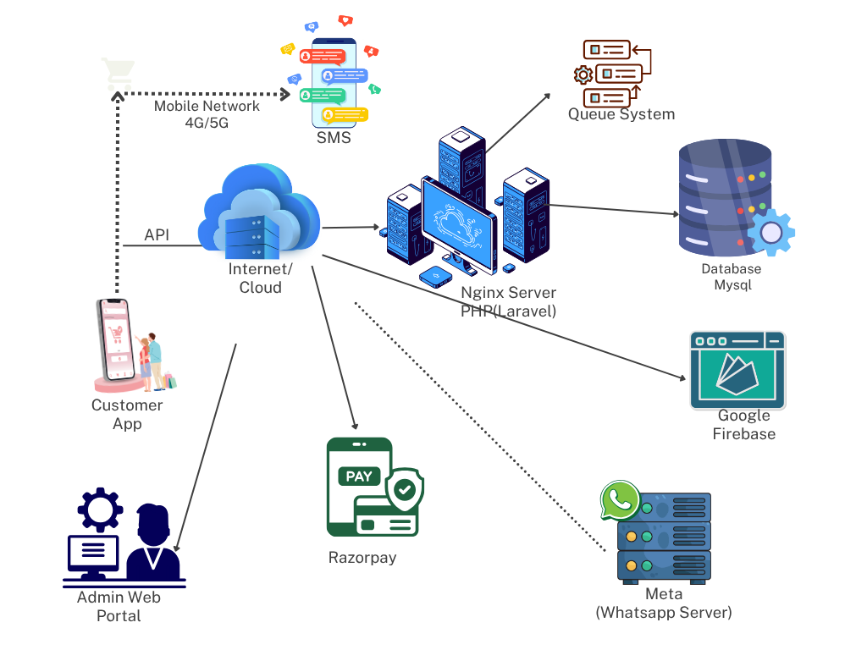
SHINYHIVE ARCHITECTURE

Slide 15
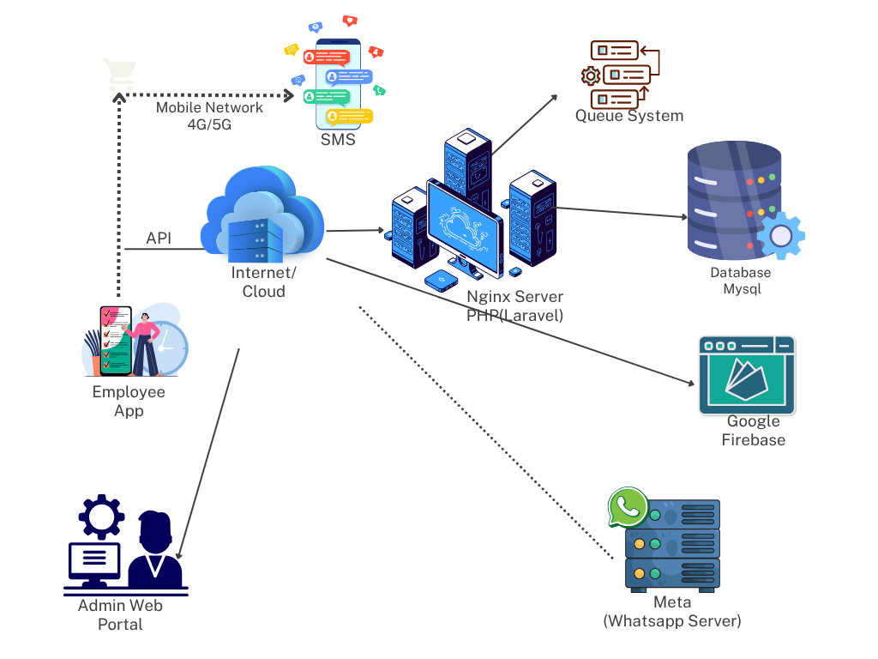
SHINYHIVE ARCHITECTURE
EMPLOYEE

Slide 16

DEMO
1. Booking flow (Customer app)
2. Payment integration screen
3. Employee job view
4. Admin Panel
5. Customer App Employee App Code
6. Deploying Apps to the playstore
7.Firebase Screens

Slide 17
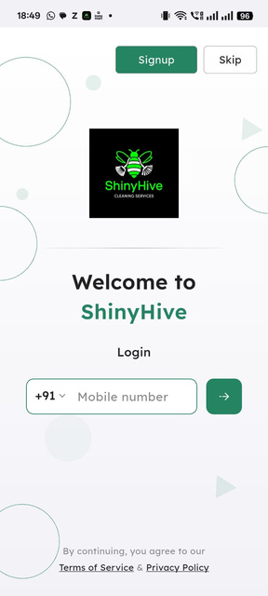
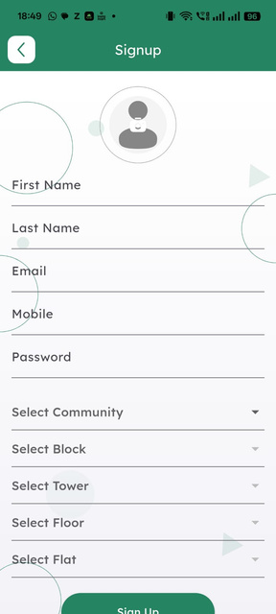
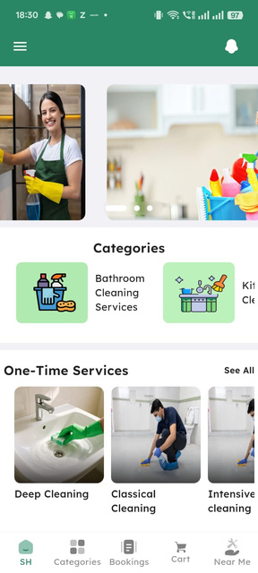
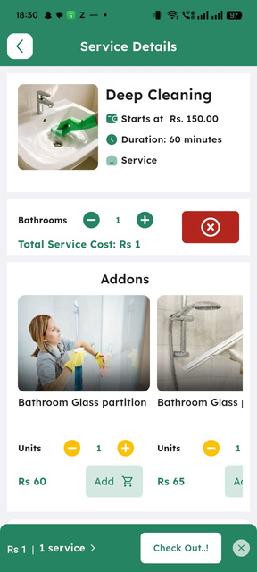
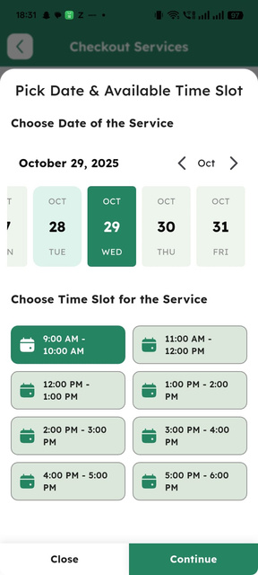
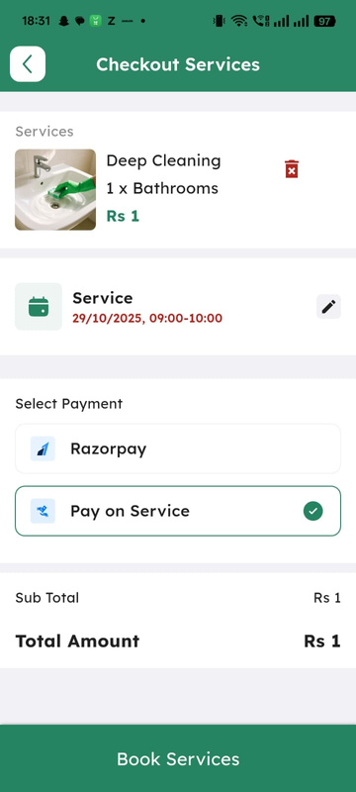
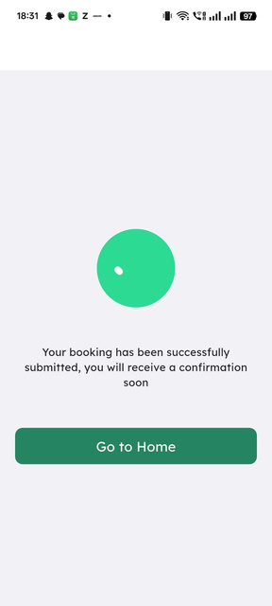
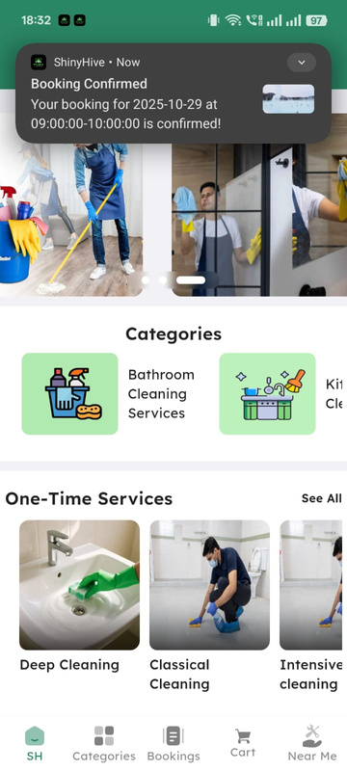
DEMO
CUSTOMER APP FLOW

Slide 18
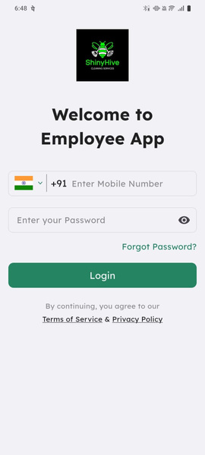
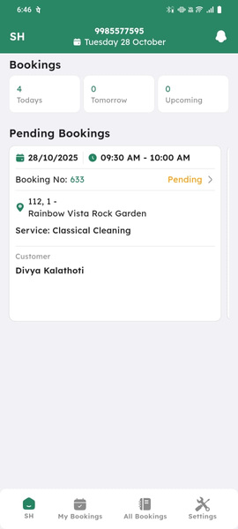
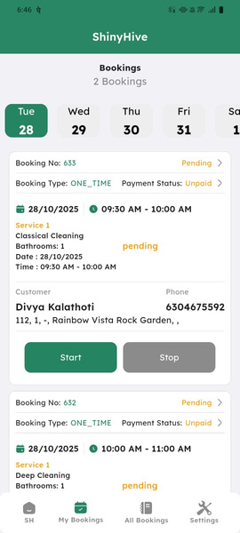
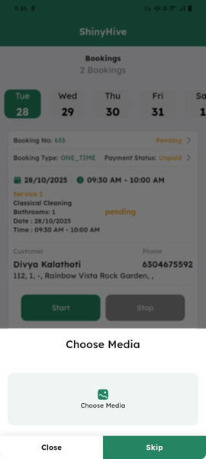
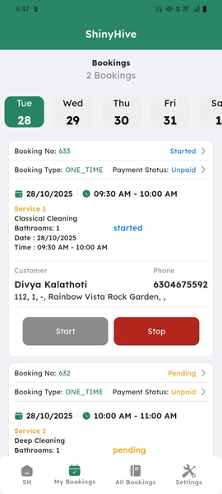
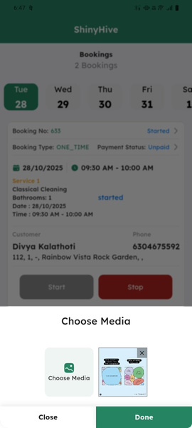
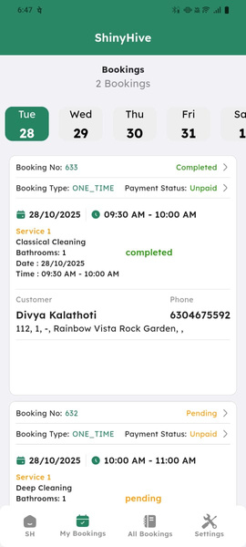
DEMO
EMPLOYEE APP FLOW

Slide 19

CHALLENGES
1. Managing recurring services
efficiently
2. Handling payment failures & retries
3. Ensuring real-time notifications
4. Synchronizing employee schedules

Slide 20

SOLUTIONS
1.Cron jobs for recurring services
2. Retry logic for failed payments
3. Queue system + Firebase for
real-time push notifications
4. Optimized employee assignment
algorithm

Slide 21

CONCLUSION
-ShinyHive brings convenience & efficiency to
bathroom cleaning services
- Delivers value to customers, employees, and administrators
-Scalable solution for future service
expansions

Slide 22

THANK YOU

