Slide 1
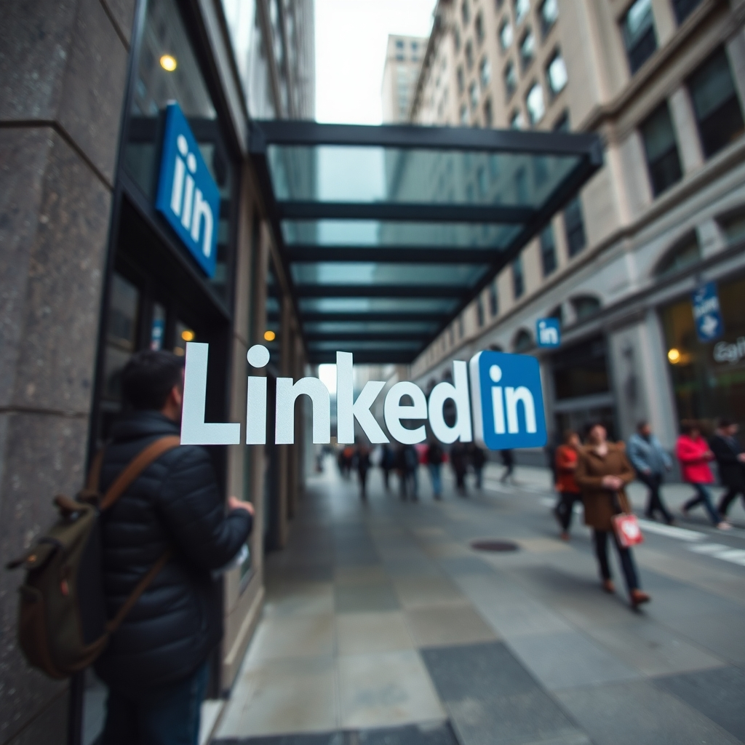
The Engineering Journey of LinkedIn
From Monolith to Microservices
Understanding how LinkedIn scaled to serve 1 billion professionals worldwide

Slide 2
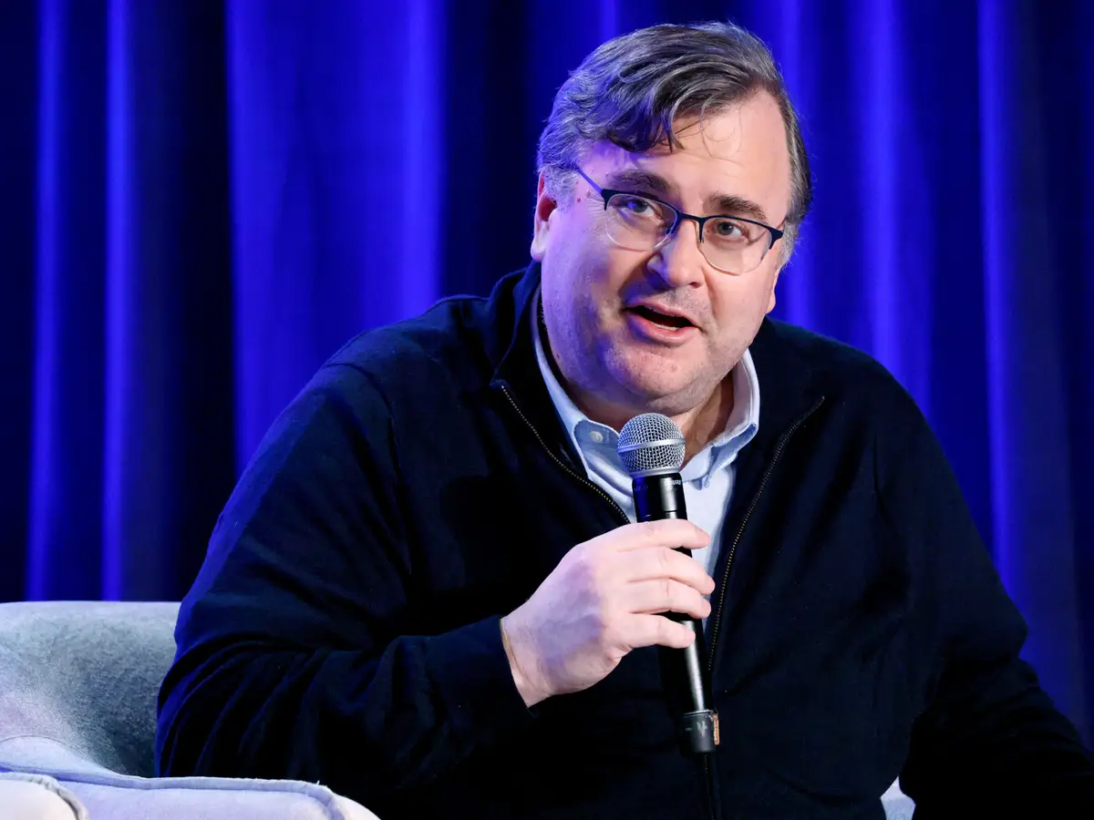
How LinkedIn Started
1
2002
Founded by Reid Hoffman and team with a vision for professional networking
2
May 2003
Official launch connecting professionals worldwide
3
2005
Rapid growth begins, scaling challenges emerge

Slide 3
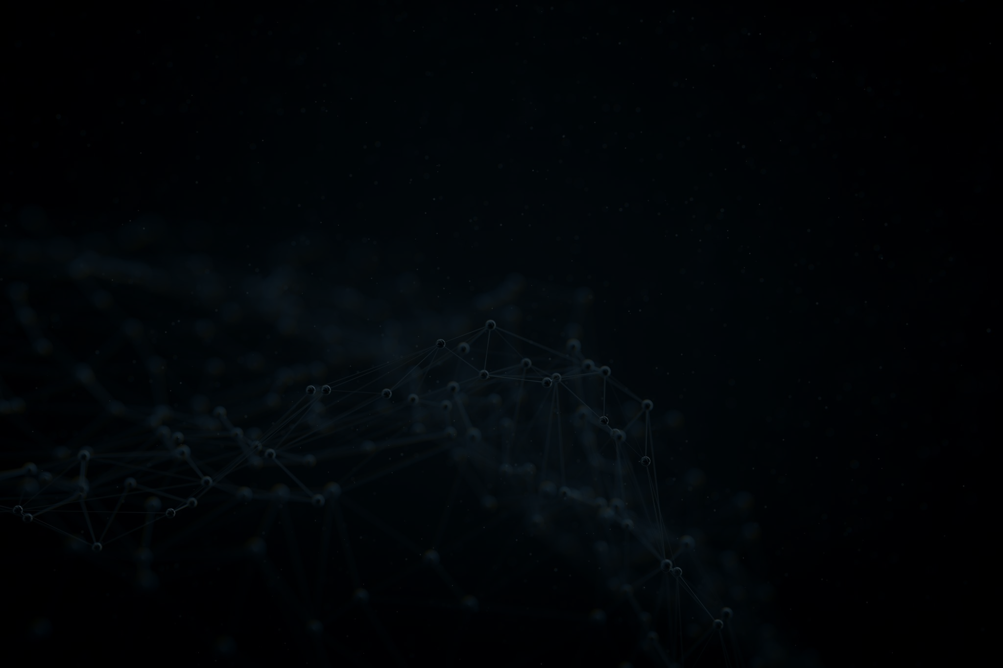
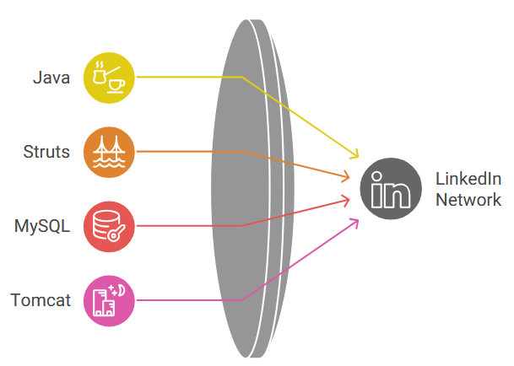
Early Architecture
The Monolithic Beginning
LinkedIn started with a single monolithic Java application containing all features in one codebase.
Monolithic App
Profiles • Jobs • Feed • Messages
Tech stack: Java, JSP, Struts framework
Single MySQL database
One deployment for all updates
All features tightly coupled together

Slide 4

Scaling Challenges & Bottlenecks
Scaling Limitations
Impossible to scale individual features independently
User Growth
Millions of users caused severe performance slowdowns across the platform
Database Overload
Single database became a critical bottleneck under heavy load

Slide 5
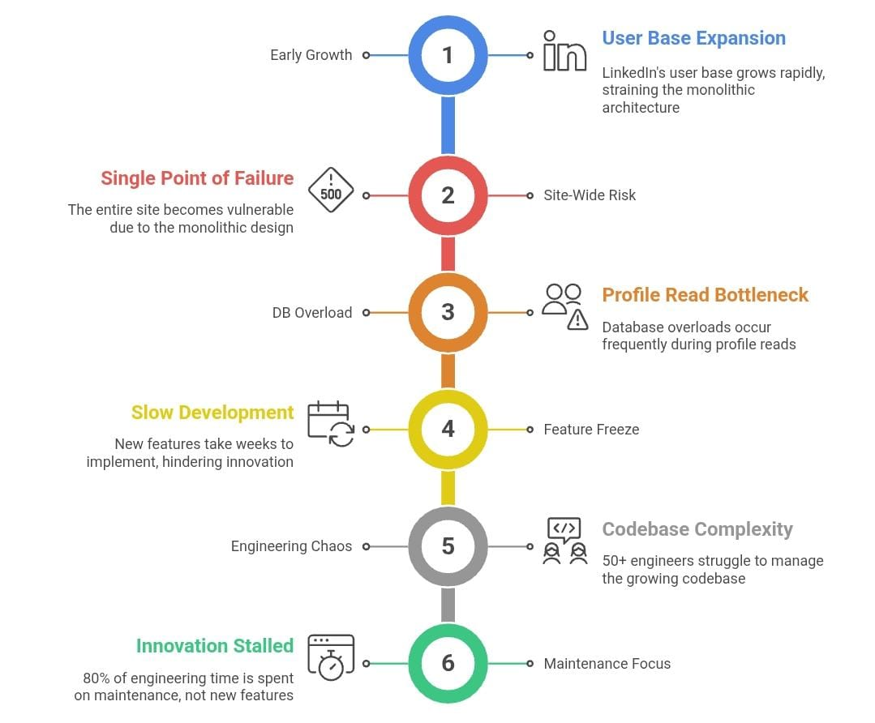
LinkedIn’s Monolith Challenges and Transition

Slide 6




Transition to Service-Oriented Architecture
LinkedIn evolved from a monolith to independent services, each with its own data and logic.
Profile Service
Feed Service
Messaging Service
User data management
Content delivery
Communication
Kafka introduced for asynchronous communication between services, enabling real-time data streaming
Split the monolith into independent services
Each service had its own data and logic
Introduced internal REST APIs
Adopted Kafka for asynchronous communication

Slide 7
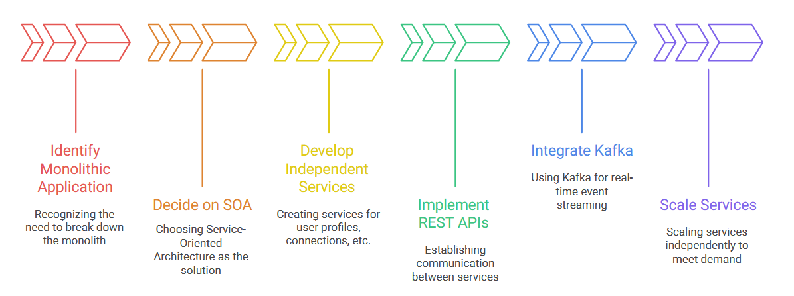
Transition to Service-Oriented Architecture at LinkedIn

Slide 8
Evolution of the Data Layer
LinkedIn moved from a single database to distributed data stores, building custom solutions for massive scale.
Kafka Streaming
User Actions
Espresso Storage
Gobblin Ingestion
Hadoop Analytics
Data Layer Evolution
Real-time event distribution
Events captured from user interactions
Custom Solutions
Data collection framework
Custom distributed database
Voldemort: Key-value store
Espresso: Document store
Open Source Tools
Big data processing
Apache Kafka
Apache Hadoop

Slide 9
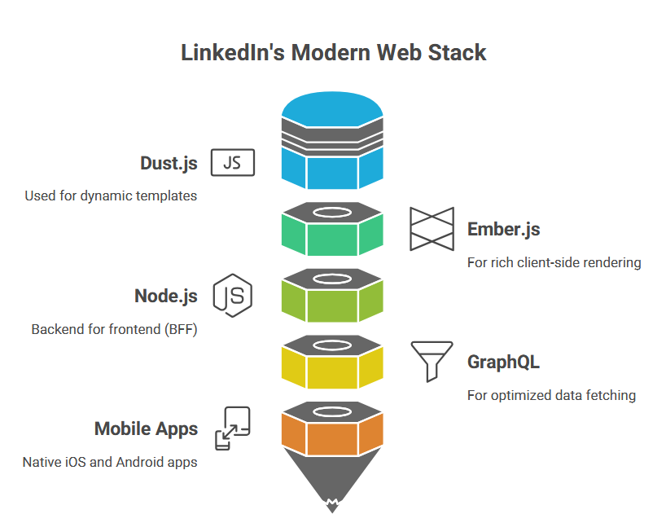




Frontend Transformation
Modern Web Stack Evolution
Legacy JSP
Server-side rendering with Java
Dust.js & Ember.js
Client-side templating and frameworks
Node.js BFF
Backend-for-Frontend layer
GraphQL
Efficient data fetching
Native mobile apps built for iOS and Android, providing optimized experiences across all platforms.

Slide 10

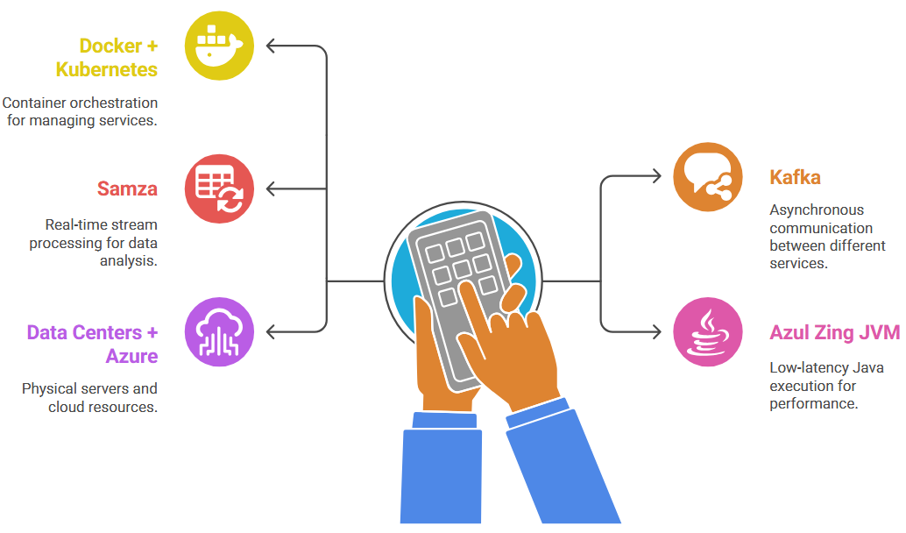


Infrastructure & Deployment
Container Orchestration
Docker containers managed by Kubernetes enable efficient resource utilization and rapid scaling.
Samza
Stream processing framework
Canary Deployments
Safe rollout strategy
Microsoft Azure
Cloud integration

Slide 11
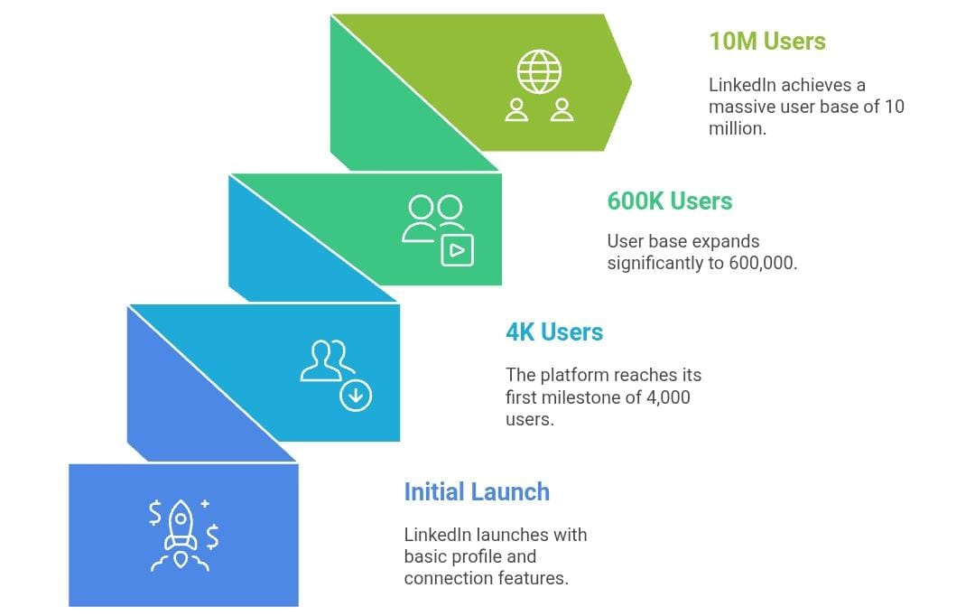
Modern LinkedIn Architecture
Event-Driven at Scale
100K+
Service Instances
Distributed across global infrastructure
1B
Professionals
7T+
Served worldwide
Events Per Day
Processed through Kafka backbone
Microservices architecture powered by Kafka enables personalized AI experiences, real-time updates, and massive scalability.

Slide 12
AI and Personalization Systems
AI for Feed Ranking, Job Recommendations, and Profile Suggestions
🔸 Feed Ranking
When you open LinkedIn, you don’t see a random list of posts. LinkedIn’s AI ranks posts based on:
Your interests, job, skills, network
Type of content you engage with (likes, comments)
🔸 Tools Used
Machine Learning models built using TensorFlow and PyTorch
Apache Kafka (for real-time event streaming)
🔸 Job Recommendations
Your skills, experience, and behavior with
Job postings and recruiter preferences
🔸 Tools Used
LinkedIn Economic Graph (a graph of people, jobs, skills, and companies)
Graph neural networks (GNNs) for matching patterns in the graph

Slide 13
Security - What LinkedIn Uses
“LinkedIn secures login using traditional credentials plus modern methods like
OAuth2,
2FA,
passkeys,
and enterprise SSO.
The platform combines transport security, session management,
and anomaly detection to prevent unauthorized access while supporting
scalable API integration.

Slide 14
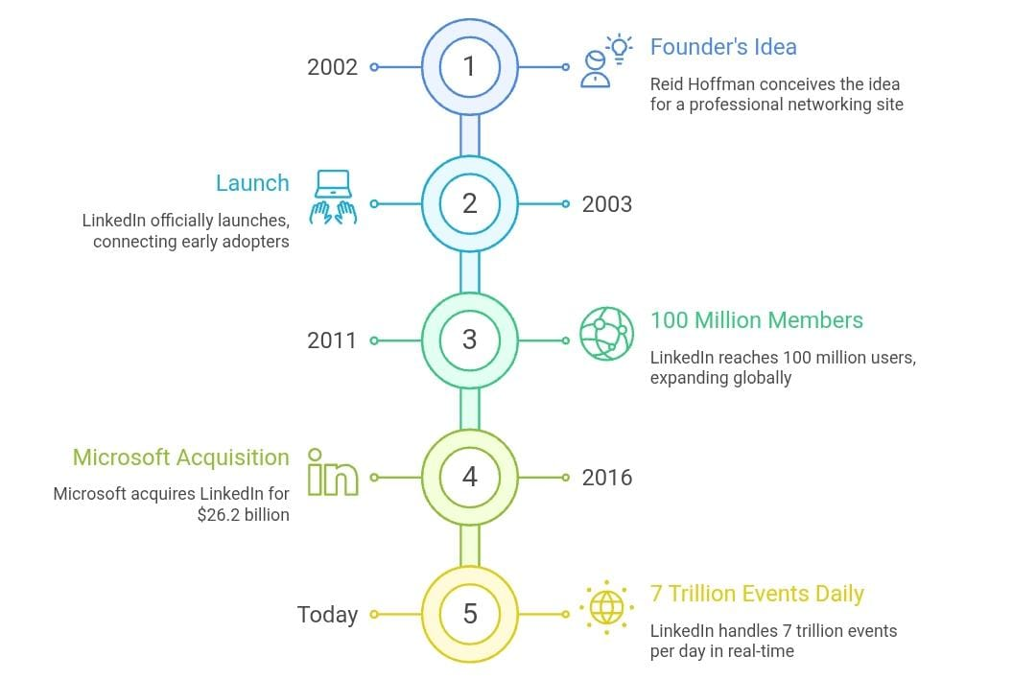
Overall View

Slide 15



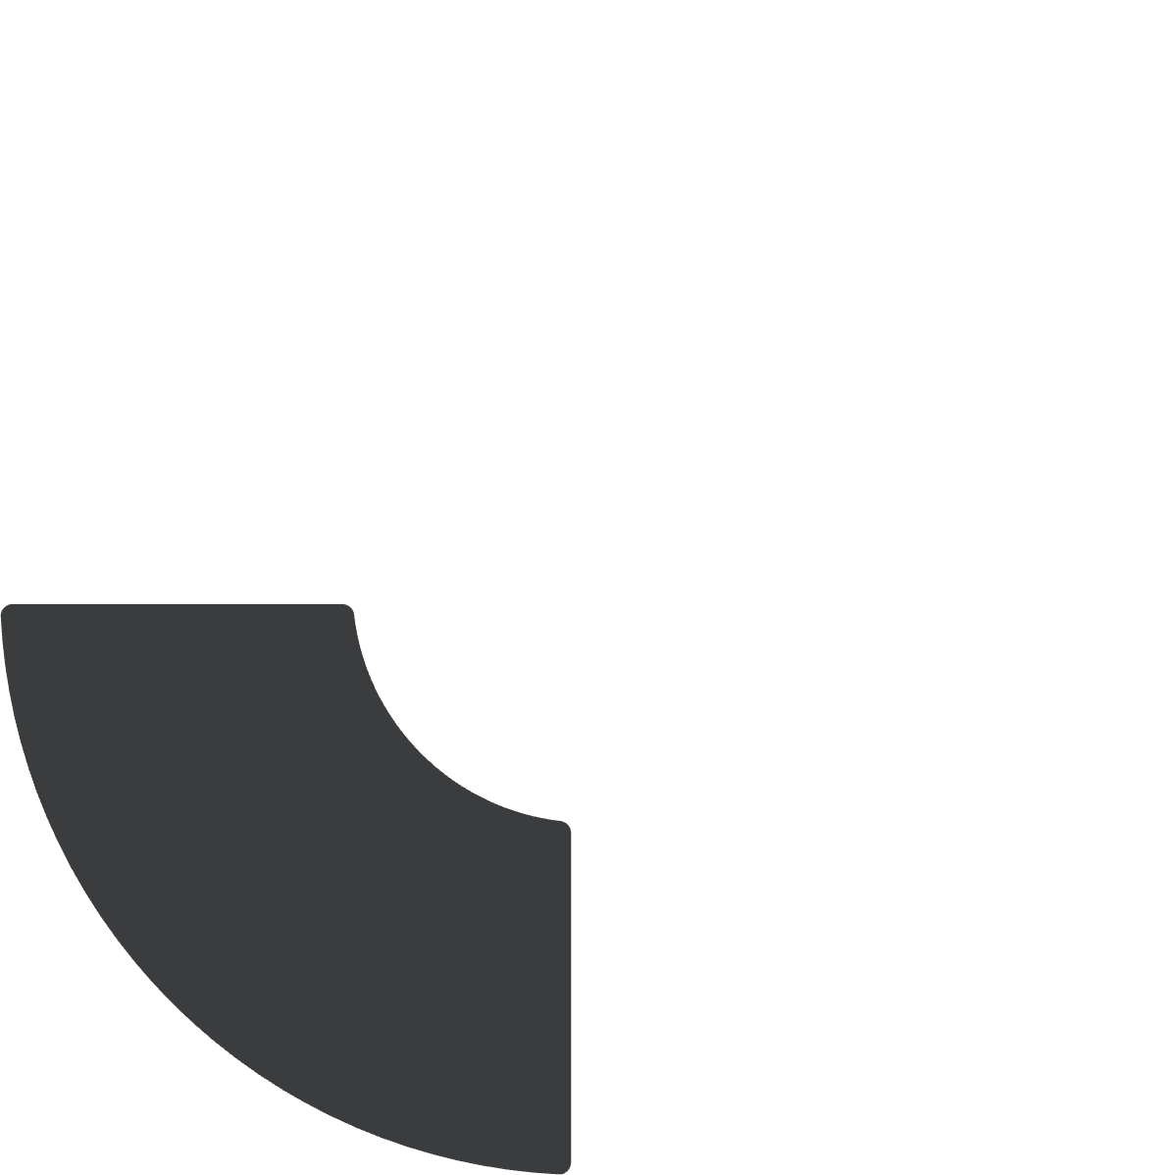

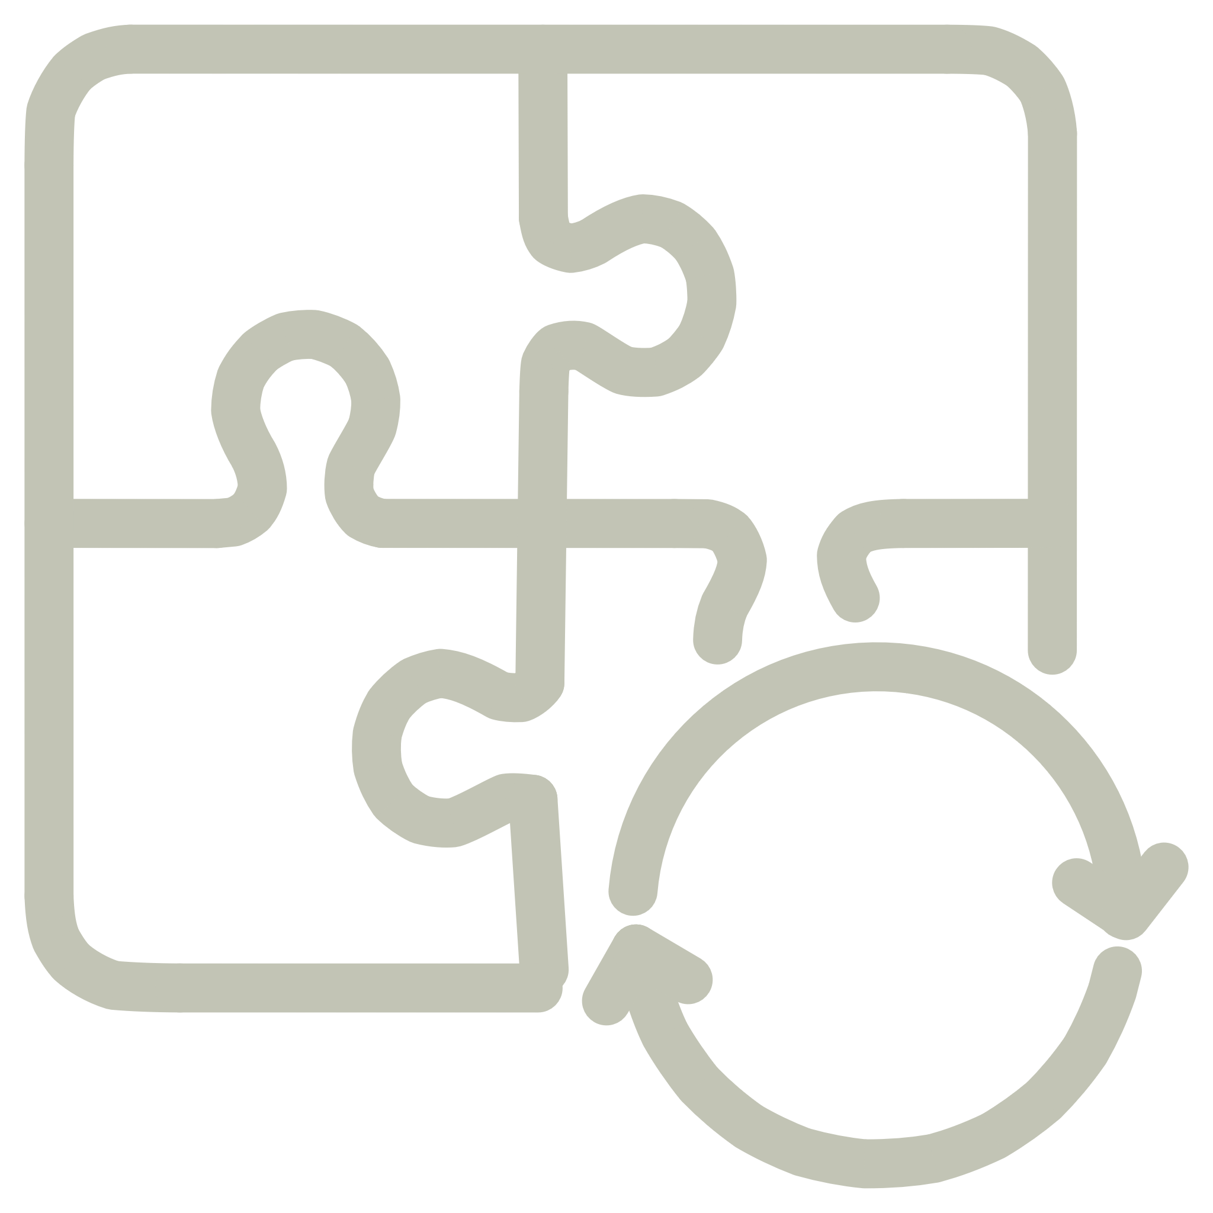


Key Takeaways
Start Simple
Evolve Gradually
Monoliths work until scale demands change
SOA to microservices was a journey, not a switch
Build Custom Tools
Data is Core
Sometimes you need to create your own solutions
Event-driven architecture enables real-time experiences

Slide 16
Thank You

